Slide 1
Spectra

Slide 2
Dispersion Review
When light is refracted, its frequency remains constant but its velocity and wavelength change.
The refractive index of a material varies depending on the wavelength of the light travelling through it – or, put simply, different colours bend different amounts.
Specifically, the shorter its wavelength, the more a light wave is refracted.
Because of this, white light – which is a combination of the entire visible spectrum – can be separated into its individual colours when it passes through a transparent material at an angle. This is called dispersion.

Slide 3
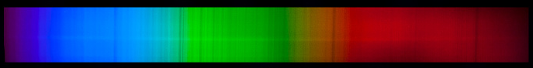
Fraunhofer Lines
It is commonly known that the sun emits light from across (and beyond) the visible spectrum, which we experience as white light.
However, when German physicist Joseph von Fraunhofer was studying sunlight in 1814, he made a strange discovery: some parts of the spectrum were mysteriously missing, forming dark lines at certain wavelengths.
Almost half a century later, Gustav Kirchhoff and Robert Bunsen noticed that these dark lines (which are now called Fraunhofer lines) matched the light emitted by certain elements when they were heated.
They deduced that those same elements must be absorbing the missing wavelengths of light somewhere between the Sun and the Earth.

Slide 4
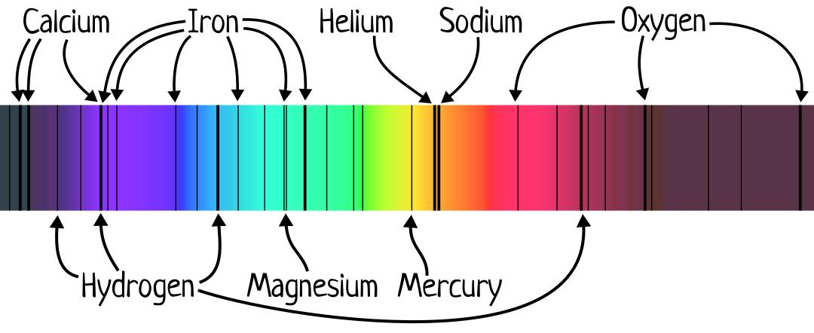
Absorption Spectra
By matching the missing wavelengths of light to the elements that emitted them, the two scientists were able to determine what the sun was made of – mostly hydrogen, with small amounts of helium and other heavier elements.
A few of the lines were caused by oxygen in the Earth’s atmosphere absorbing light.
Spectra with missing wavelengths like this one were named absorption spectra.

Slide 5
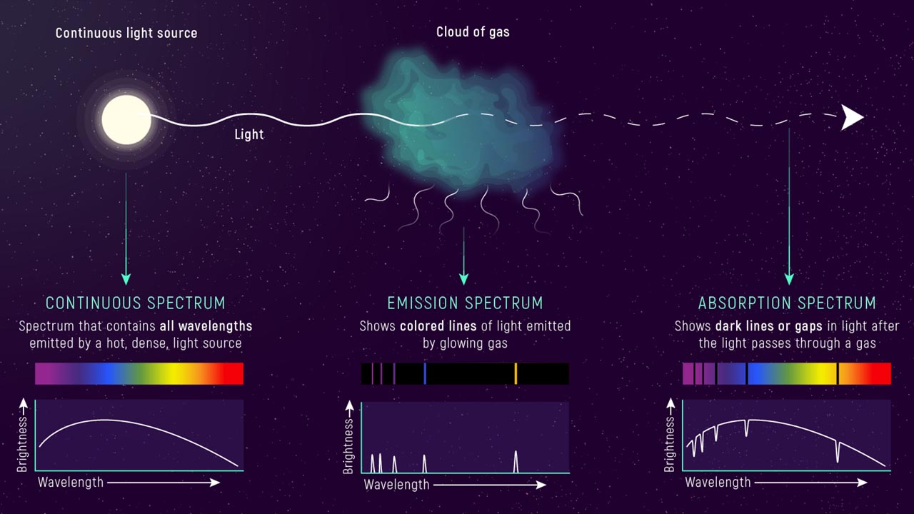
Emission Spectra
The unique set of wavelengths of light emitted by an element is known as its emission spectrum, and is useful for identifying elements (spectroscopy).
Elements only emit light when they are ‘excited’ by:
High temperatures
An electric current
Electron bombardment
Photoexcitation (i.e. excitement caused by certain frequencies of light)
But why were these few specific wavelengths the only ones being produced?

Slide 6
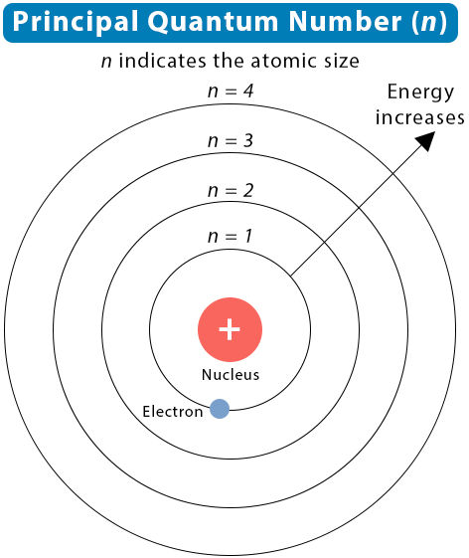
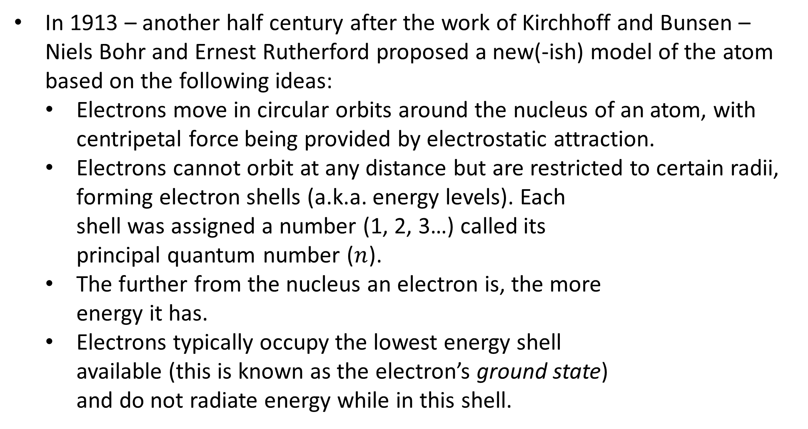
The Bohr Model
In 1913 – another half century after the work of Kirchhoff and Bunsen – Niels Bohr and Ernest Rutherford proposed a new(-ish) model of the atom based on the following ideas:
Electrons move in circular orbits around the nucleus of an atom, with centripetal force being provided by electrostatic attraction.
Electrons cannot orbit at any distance but are restricted to certain radii, forming electron shells (a.k.a. energy levels). Each shell was assigned a number (1, 2, 3…) called its principal quantum number ($n$).
The further from the nucleus an electron is, the more energy it has.
Electrons typically occupy the lowest energy shell available (this is known as the electron’s ground state) and do not radiate energy while in this shell.
Notes:
Note that this model worked really well for small atoms but started to fall apart a bit when it came to bigger atoms.

Slide 7
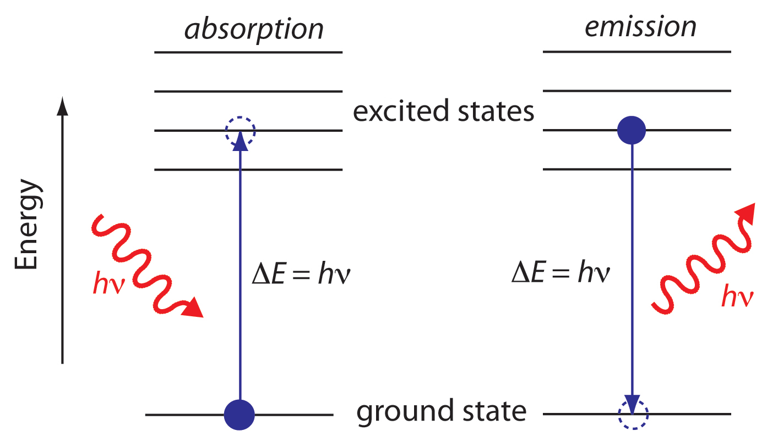
The Bohr Model
Using his model, Bohr explained that an atom could only absorb a photon if:
The photon had enough energy to free an electron from the nucleus entirely, forming an ion (this is known as an atom’s ionisation energy), or
The photon had just the right amount of energy to move an electron from its current energy level to a higher one.
Conversely, atoms emit photons when their electrons drop from one energy level to another, and these photons always have the amount of energy corresponding to the difference between the two levels.

Slide 8
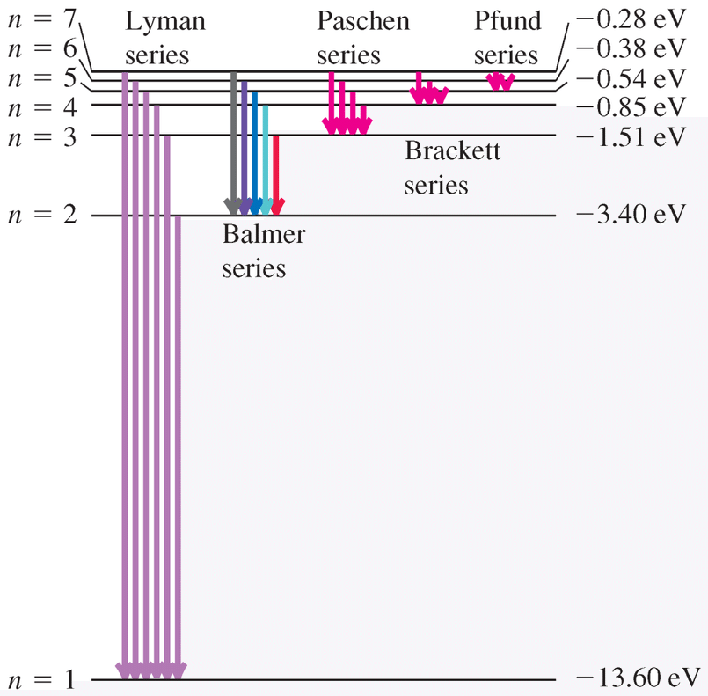
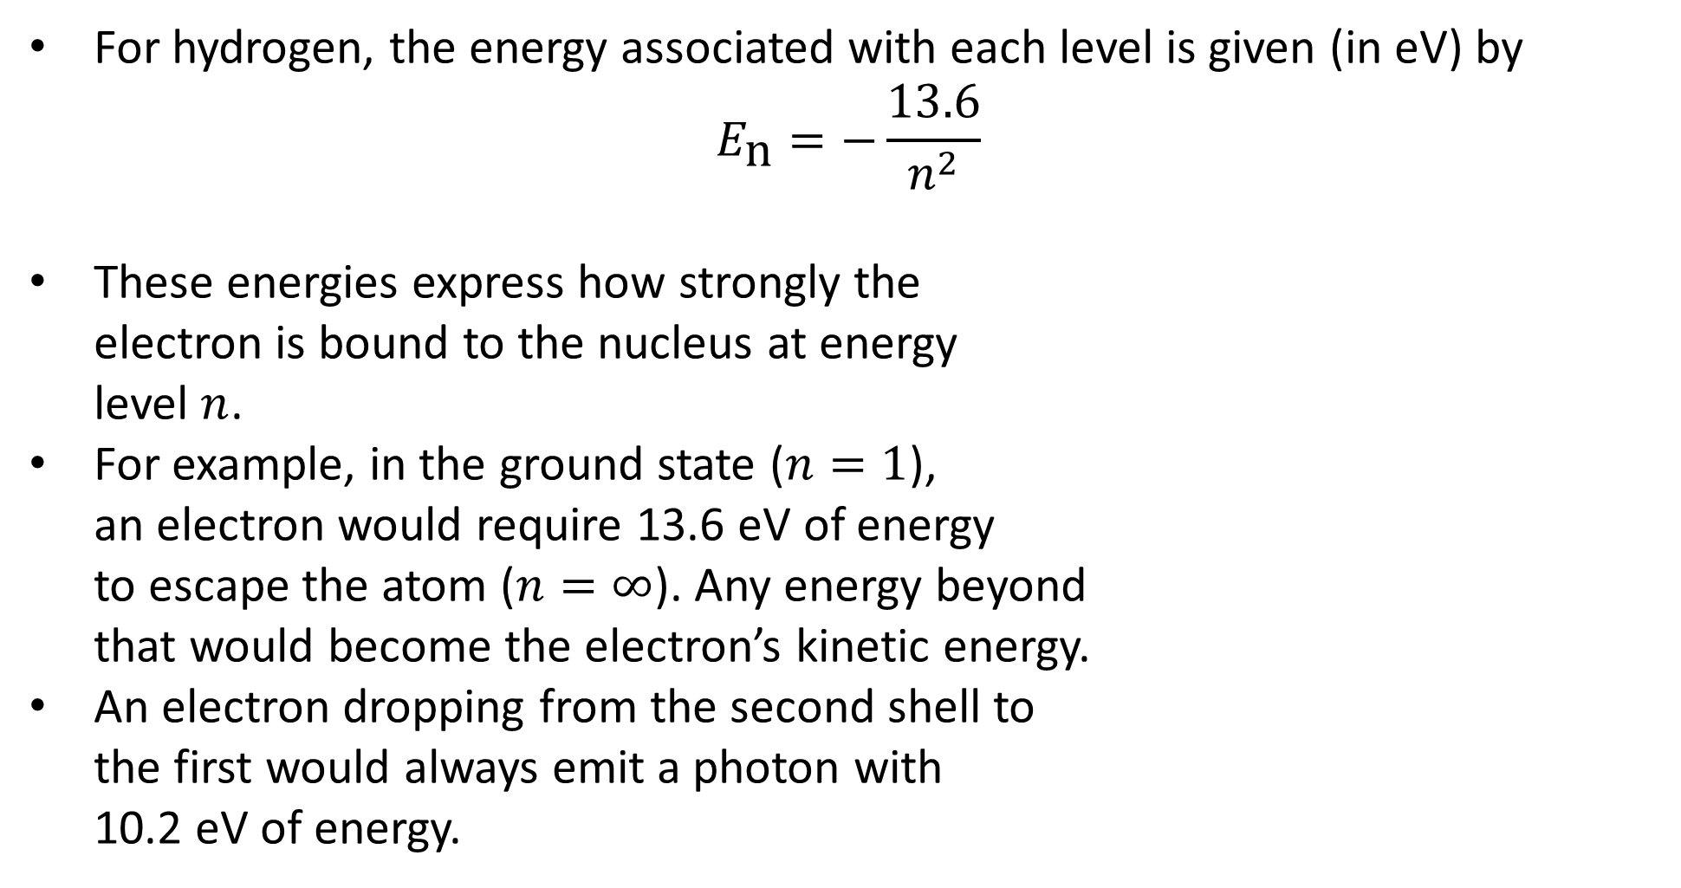
The Bohr Model
For hydrogen, the energy associated with each level is given (in eV) by
$$E_{\text{n}}=−\frac{13.6}{n^{2}}$$
These energies express how strongly the electron is bound to the nucleus at energy level $n$.
For example, in the ground state ($n=1$), an electron would require 13.6 eV of energy to escape the atom ($n=∞$). Any energy beyond that would become the electron’s kinetic energy.
An electron dropping from the second shell to the first would always emit a photon with 10.2 eV of energy.

